Slide 1
Unit V - Cluster Analysis

Slide 2
What is Cluster Analysis?
Cluster: a collection of data objects
  Similar to one another within the same cluster
  Dissimilar to the objects in other clusters
Cluster analysis
  Finding similarities between data according to the characteristics found in the data and grouping similar data objects into clusters
Unsupervised learning: no predefined classes
Typical applications
  As a stand-alone tool to get insight into data distribution
  As a preprocessing step for other algorithms

Slide 3
Clustering: Rich Applications and Multidisciplinary Efforts
Pattern Recognition
Spatial Data Analysis
  Create thematic maps in GIS by clustering feature spaces
  Detect spatial clusters or for other spatial mining tasks
Image Processing
Economic Science (especially market research)
WWW
  Document classification
  Cluster Weblog data to discover groups of similar access patterns

Slide 4
Examples of Clustering Applications
Marketing: Help marketers discover distinct groups in their customer bases, and then use this knowledge to develop targeted marketing programs
Land use: Identification of areas of similar land use in an earth observation database
Insurance: Identifying groups of motor insurance policy holders with a high average claim cost
City-planning: Identifying groups of houses according to their house type, value, and geographical location
Earth-quake studies: Observed earth quake epicenters should be clustered along continent faults

Slide 5
Quality: What Is Good Clustering?
A good clustering method will produce high quality clusters with
  high intra-class similarity
  low inter-class similarity
The quality of a clustering result depends on both the similarity measure used by the method and its implementation
The quality of a clustering method is also measured by its ability to discover some or all of the hidden patterns

Slide 6
Measure the Quality of Clustering
Dissimilarity/Similarity metric: Similarity is expressed in terms of a distance function, typically metric: d(i, j)
There is a separate “quality” function that measures the “goodness” of a cluster.
The definitions of distance functions are usually very different for interval-scaled, boolean, categorical, ordinal ratio, and vector variables.
Weights should be associated with different variables based on applications and data semantics.
It is hard to define “similar enough” or “good enough”
  the answer is typically highly subjective.

Slide 7
Requirements of Clustering in Data Mining
Scalability
Ability to deal with different types of attributes
Ability to handle dynamic data
Discovery of clusters with arbitrary shape
Minimal requirements for domain knowledge to determine input parameters
Able to deal with noise and outliers
Insensitive to order of input records
High dimensionality
Incorporation of user-specified constraints
Interpretability and usability

Slide 8


Data Structures
Data matrix
  (two modes)
Dissimilarity matrix
  (one mode)

Slide 9
Type of data in clustering analysis
Interval-scaled variables
Binary variables
Nominal, ordinal, and ratio variables
Variables of mixed types

Slide 10


Interval-valued variables
Standardize data
  Calculate the mean absolute deviation:
  where
  Calculate the standardized measurement (z-score)
Using mean absolute deviation is more robust than using standard deviation

Slide 11


Similarity and Dissimilarity Between Objects
Distances are normally used to measure the similarity or dissimilarity between two data objects
Some popular ones include: Minkowski distance:
  where i = (x_{i1}, x_{i2}, …, x_{ip}) and j = (x_{j1}, x_{j2}, …, x_{jp}) are two p-dimensional data objects, and q is a positive integer
If q = 1, d is Manhattan distance

Slide 12

Similarity and Dissimilarity Between Objects (Cont.)
If q = 2, d is Euclidean distance:
  Properties
    d(i,j) ≥ 0
    d(i,i) = 0
    d(i,j) = d(j,i)
    d(i,j) ≤ d(i,k) + d(k,j)
Also, one can use weighted distance, parametric Pearson product moment correlation, or other disimilarity measures

Slide 13


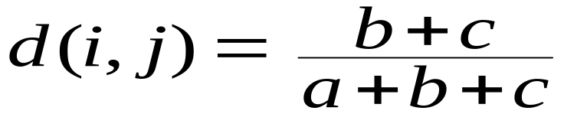
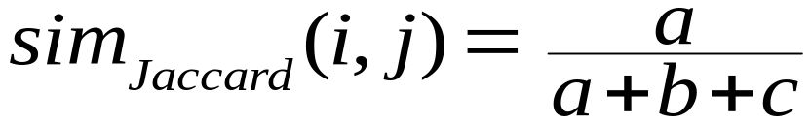
Binary Variables
Object j
A contingency table for binary data
Distance measure for symmetric binary variables:
Distance measure for asymmetric binary variables:
Jaccard coefficient (similarity measure for asymmetric binary variables):
Object i

Slide 14


Dissimilarity between Binary Variables
Example
  gender is a symmetric attribute
  the remaining attributes are asymmetric binary
  let the values Y and P be set to 1, and the value N be set to 0

Slide 15

Nominal Variables
A generalization of the binary variable in that it can take more than 2 states, e.g., red, yellow, blue, green
Method 1: Simple matching
  m: # of matches, p: total # of variables
Method 2: use a large number of binary variables
  creating a new binary variable for each of the M nominal states

Slide 16


Ordinal Variables
An ordinal variable can be discrete or continuous
Order is important, e.g., rank
Can be treated like interval-scaled
  replace x_{if} by their rank
  map the range of each variable onto [0, 1] by replacing i-th object in the f-th variable by
  compute the dissimilarity using methods for interval-scaled variables

Slide 17
Ratio-Scaled Variables
Ratio-scaled variable: a positive measurement on a nonlinear scale, approximately at exponential scale, such as Ae^{Bt} or Ae^{-Bt}
Methods:
  treat them like interval-scaled variables—not a good choice! (why?—the scale can be distorted)
  apply logarithmic transformation
y_{if} = log(x_{if})
  treat them as continuous ordinal data treat their rank as interval-scaled

Slide 18


Variables of Mixed Types
A database may contain all the six types of variables
  symmetric binary, asymmetric binary, nominal, ordinal, interval and ratio
One may use a weighted formula to combine their effects
  f is binary or nominal:
    d_{ij}^{(f)} = 0 if x_{if} = x_{jf} , or d_{ij}^{(f)} = 1 otherwise
  f is interval-based: use the normalized distance
  f is ordinal or ratio-scaled
    compute ranks r_{if} and
    and treat z_{if} as interval-scaled

Slide 19


Vector Objects
Vector objects: keywords in documents, gene features in micro-arrays, etc.
Broad applications: information retrieval, biologic taxonomy, etc.
Cosine measure
A variant: Tanimoto coefficient

Slide 20
Major Clustering Approaches (I)
Partitioning approach:
  Construct various partitions and then evaluate them by some criterion, e.g., minimizing the sum of square errors
  Typical methods: k-means, k-medoids, CLARANS
Hierarchical approach:
  Create a hierarchical decomposition of the set of data (or objects) using some criterion
  Typical methods: Diana, Agnes, BIRCH, ROCK, CAMELEON
Density-based approach:
  Based on connectivity and density functions
  Typical methods: DBSACN, OPTICS, DenClue

Slide 21
Major Clustering Approaches (II)
Grid-based approach:
  based on a multiple-level granularity structure
  Typical methods: STING, WaveCluster, CLIQUE
Model-based:
  A model is hypothesized for each of the clusters and tries to find the best fit of that model to each other
  Typical methods: EM, SOM, COBWEB
Frequent pattern-based:
  Based on the analysis of frequent patterns
  Typical methods: pCluster
User-guided or constraint-based:
  Clustering by considering user-specified or application-specific constraints
  Typical methods: COD (obstacles), constrained clustering

Slide 22
Typical Alternatives to Calculate the Distance between Clusters
Single link: smallest distance between an element in one cluster and an element in the other, i.e., dis(K_{i}, K_{j}) = min(t_{ip}, t_{jq})
Complete link: largest distance between an element in one cluster and an element in the other, i.e., dis(K_{i}, K_{j}) = max(t_{ip}, t_{jq})
Average: avg distance between an element in one cluster and an element in the other, i.e., dis(K_{i}, K_{j}) = avg(t_{ip}, t_{jq})
Centroid: distance between the centroids of two clusters, i.e., dis(K_{i}, K_{j}) = dis(C_{i}, C_{j})
Medoid: distance between the medoids of two clusters, i.e., dis(K_{i}, K_{j}) = dis(M_{i}, M_{j})
  Medoid: one chosen, centrally located object in the cluster

Slide 23
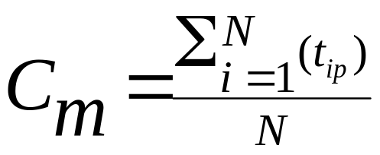
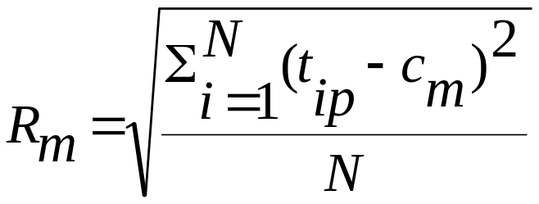

Centroid, Radius and Diameter of a Cluster (for numerical data sets)
Centroid: the “middle” of a cluster
Radius: square root of average distance from any point of the cluster to its centroid
Diameter: square root of average mean squared distance between all pairs of points in the cluster

Slide 24
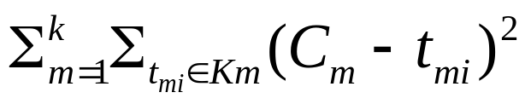
Partitioning Algorithms: Basic Concept
Partitioning method: Construct a partition of a database D of n objects into a set of k clusters, s.t., min sum of squared distance
Given a k, find a partition of k clusters that optimizes the chosen partitioning criterion
  Global optimal: exhaustively enumerate all partitions
  Heuristic methods: k-means and k-medoids algorithms
  k-means (MacQueen’67): Each cluster is represented by the center of the cluster
  k-medoids or PAM (Partition around medoids) (Kaufman & Rousseeuw’87): Each cluster is represented by one of the objects in the cluster

Slide 25
The K-Means Clustering Method
Given k, the k-means algorithm is implemented in four steps:
  Partition objects into k nonempty subsets
  Compute seed points as the centroids of the clusters of the current partition (the centroid is the center, i.e., mean point, of the cluster)
  Assign each object to the cluster with the nearest seed point
  Go back to Step 2, stop when no more new assignment

Slide 26



The K-Means Clustering Method
Example
10
10
9
9
8
8
7
7
6
6
5
5
4
Assign each objects to most similar center
Update the cluster means
4
3
3
2
2
1
1
0
0
0
1
2
3
4
5
6
7
8
9
10
0
1
2
3
4
5
6
7
8
9
10
reassign
reassign
K=2
Arbitrarily choose K object as initial cluster center
Update the cluster means

Slide 27
Comments on the K-Means Method
Strength: Relatively efficient: O(tkn), where n is # objects, k is # clusters, and t is # iterations. Normally, k, t << n.
    Comparing: PAM: O(k(n-k)² ), CLARA: O(ks² + k(n-k))
Comment: Often terminates at a local optimum. The global optimum may be found using techniques such as: deterministic annealing and genetic algorithms
Weakness
  Applicable only when mean is defined, then what about categorical data?
  Need to specify k, the number of clusters, in advance
  Unable to handle noisy data and outliers
  Not suitable to discover clusters with non-convex shapes

Slide 28
Variations of the K-Means Method
A few variants of the k-means which differ in
  Selection of the initial k means
  Dissimilarity calculations
  Strategies to calculate cluster means
Handling categorical data: k-modes (Huang’98)
  Replacing means of clusters with modes
  Using new dissimilarity measures to deal with categorical objects
  Using a frequency-based method to update modes of clusters
  A mixture of categorical and numerical data: k-prototype method

Slide 29
What Is the Problem of the K-Means Method?
The k-means algorithm is sensitive to outliers !
  Since an object with an extremely large value may substantially distort the distribution of the data.
K-Medoids: Instead of taking the mean value of the object in a cluster as a reference point, medoids can be used, which is the most centrally located object in a cluster.
10
10
9
9
8
8
7
7
6
6
5
5
4
4
3
3
2
2
1
1
0
0
1
2
3
4
5
6
7
8
9
10
0
0
1
2
3
4
5
6
7
8
9
10

Slide 30
The K-Medoids Clustering Method
Find representative objects, called medoids, in clusters
PAM (Partitioning Around Medoids, 1987)
  starts from an initial set of medoids and iteratively replaces one of the medoids by one of the non-medoids if it improves the total distance of the resulting clustering
  PAM works effectively for small data sets, but does not scale well for large data sets
CLARA (Kaufmann & Rousseeuw, 1990)
CLARANS (Ng & Han, 1994): Randomized sampling
Focusing + spatial data structure (Ester et al., 1995)

Slide 31

A Typical K-Medoids Algorithm (PAM)
Total Cost = 20
10
9
8
Arbitrary choose k object as initial medoids
Assign each remaining object to nearest medoids
7
6
5
4
3
2
1
0
0
1
2
3
4
5
6
7
8
9
10
K=2
Randomly select a nonmedoid object,O_{ramdom}
Total Cost = 26
Do loop
Until no change
10
10
9
Compute total cost of swapping
9
Swapping O and O_{ramdom}
If quality is improved.
8
8
7
7
6
6
5
5
4
4
3
3
2
2
1
1
0
0
1
2
3
4
5
6
7
8
9
10
0
0
1
2
3
4
5
6
7
8
9
10

Slide 32
PAM (Partitioning Around Medoids) (1987)
PAM (Kaufman and Rousseeuw, 1987), built in Splus
Use real object to represent the cluster
  Select k representative objects arbitrarily
  For each pair of non-selected object h and selected object i, calculate the total swapping cost TC_{ih}
  For each pair of i and h,
    If TC_{ih} < 0, i is replaced by h
    Then assign each non-selected object to the most similar representative object
  repeat steps 2-3 until there is no change

Slide 33
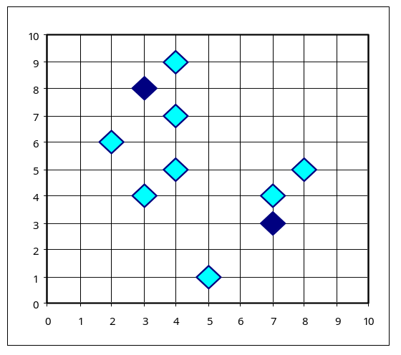
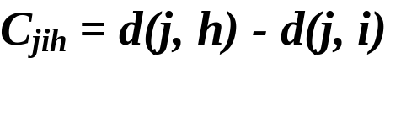

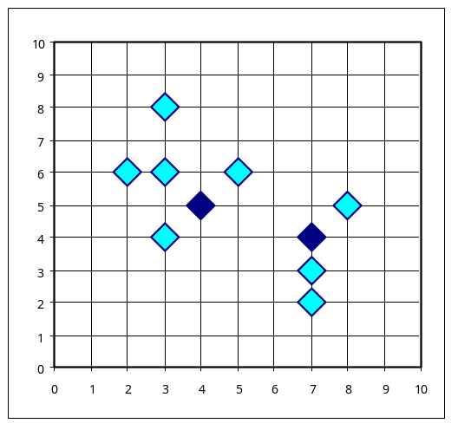
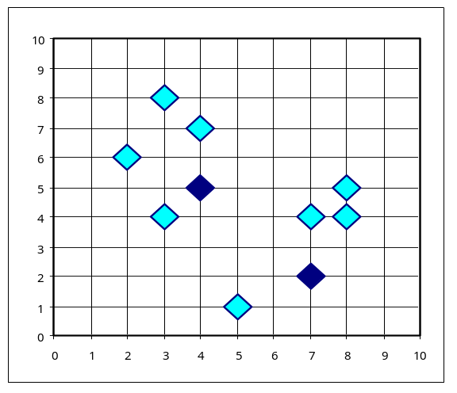


PAM Clustering: Total swapping cost TC_{ih}=∑_{j}C_{jih}
t
j
t
j
i
h
h
i
h
j
i
i
t
h
j
t

Slide 34
What Is the Problem with PAM?
Pam is more robust than k-means in the presence of noise and outliers because a medoid is less influenced by outliers or other extreme values than a mean
Pam works efficiently for small data sets but does not scale well for large data sets.
  O(k(n-k)² ) for each iteration
where n is # of data,k is # of clusters
Sampling based method,
CLARA(Clustering LARge Applications)

Slide 35
Hierarchical Clustering
Use distance matrix as clustering criteria. This method does not require the number of clusters k as an input, but needs a termination condition
Step 0
Step 1
Step 2
Step 3
Step 4
agglomerative
(AGNES)
a
a b
b
a b c d e
c
c d e
d
d e
e
divisive
(DIANA)
Step 4
Step 3
Step 2
Step 1
Step 0

Slide 36

AGNES (Agglomerative Nesting)
Introduced in Kaufmann and Rousseeuw (1990)
Implemented in statistical analysis packages, e.g., Splus
Use the Single-Link method and the dissimilarity matrix.
Merge nodes that have the least dissimilarity
Go on in a non-descending fashion
Eventually all nodes belong to the same cluster

Slide 37
Dendrogram: Shows How the Clusters are Merged
  Decompose data objects into a several levels of nested partitioning (tree of clusters), called a dendrogram.
  A clustering of the data objects is obtained by cutting the dendrogram at the desired level, then each connected component forms a cluster.

Slide 38
DIANA (Divisive Analysis)
Introduced in Kaufmann and Rousseeuw (1990)
Implemented in statistical analysis packages, e.g., Splus
Inverse order of AGNES
Eventually each node forms a cluster on its own

Slide 39
Recent Hierarchical Clustering Methods
Major weakness of agglomerative clustering methods
  do not scale well: time complexity of at least O(n²), where n is the number of total objects
  can never undo what was done previously
Integration of hierarchical with distance-based clustering
  BIRCH (1996): uses CF-tree and incrementally adjusts the quality of sub-clusters
  ROCK (1999): clustering categorical data by neighbor and link analysis
  CHAMELEON (1999): hierarchical clustering using dynamic modeling

Slide 40
Density-Based Clustering Methods
Clustering based on density (local cluster criterion), such as density-connected points
Major features:
  Discover clusters of arbitrary shape
  Handle noise
  One scan
  Need density parameters as termination condition
Several interesting studies:
  DBSCAN: Ester, et al. (KDD’96)
  OPTICS: Ankerst, et al (SIGMOD’99).
  DENCLUE: Hinneburg & D. Keim (KDD’98)
  CLIQUE: Agrawal, et al. (SIGMOD’98) (more grid-based)

Slide 41
Grid-Based Clustering Method
Using multi-resolution grid data structure
Several interesting methods
  STING (a STatistical INformation Grid approach) by Wang, Yang and Muntz (1997)
  WaveCluster by Sheikholeslami, Chatterjee, and Zhang (VLDB’98)
    A multi-resolution clustering approach using wavelet method
  CLIQUE: Agrawal, et al. (SIGMOD’98)
    On high-dimensional data (thus put in the section of clustering high-dimensional data

Slide 42
Model-Based Clustering
What is model-based clustering?
  Attempt to optimize the fit between the given data and some mathematical model
  Based on the assumption: Data are generated by a mixture of underlying probability distribution
Typical methods
  Statistical approach
    EM (Expectation maximization), AutoClass
  Machine learning approach
    COBWEB, CLASSIT
  Neural network approach
    SOM (Self-Organizing Feature Map)

Slide 43
EM — Expectation Maximization
EM — A popular iterative refinement algorithm
An extension to k-means
  Assign each object to a cluster according to a weight (prob. distribution)
  New means are computed based on weighted measures
General idea
  Starts with an initial estimate of the parameter vector
  Iteratively rescores the patterns against the mixture density produced by the parameter vector
  The rescored patterns are used to update the parameter updates
  Patterns belonging to the same cluster, if they are placed by their scores in a particular component
Algorithm converges fast but may not be in global optima

Slide 44


The EM (Expectation Maximization) Algorithm
Initially, randomly assign k cluster centers
Iteratively refine the clusters based on two steps
  Expectation step: assign each data point X_{i} to cluster C_{i} with the following probability
  Maximization step:
    Estimation of model parameters

Slide 45
Conceptual Clustering
Conceptual clustering
  A form of clustering in machine learning
  Produces a classification scheme for a set of unlabeled objects
  Finds characteristic description for each concept (class)
COBWEB (Fisher’87)
  A popular a simple method of incremental conceptual learning
  Creates a hierarchical clustering in the form of a classification tree
  Each node refers to a concept and contains a probabilistic description of that concept

Slide 46
Self-Organizing Feature Map (SOM)
SOMs, also called topological ordered maps, or Kohonen Self-Organizing Feature Map (KSOMs)
It maps all the points in a high-dimensional source space into a 2 to 3-d target space, s.t., the distance and proximity relationship (i.e., topology) are preserved as much as possible
Similar to k-means: cluster centers tend to lie in a low-dimensional manifold in the feature space
Clustering is performed by having several units competing for the current object
  The unit whose weight vector is closest to the current object wins
  The winner and its neighbors learn by having their weights adjusted
SOMs are believed to resemble processing that can occur in the brain
Useful for visualizing high-dimensional data in 2- or 3-D space

Slide 47
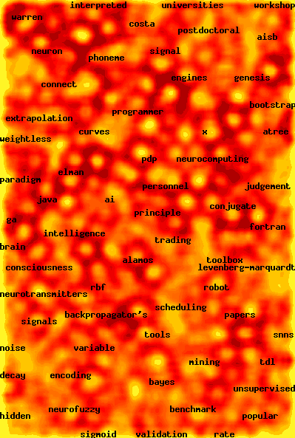
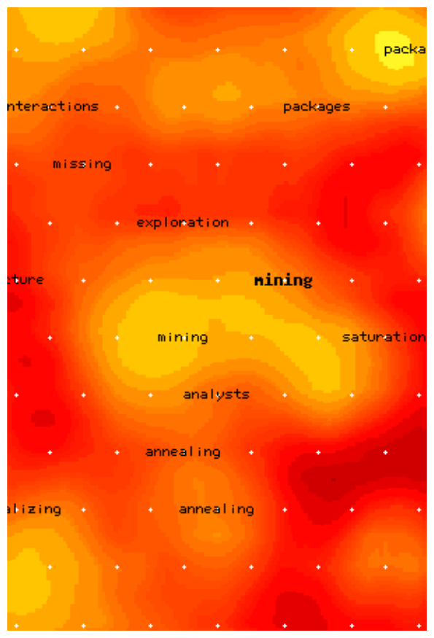
Web Document Clustering Using SOM
The result of SOM clustering of 12088 Web articles
The picture on the right: drilling down on the keyword “mining”
Based on websom.hut.fi Web page

Slide 48
Clustering High-Dimensional Data
Clustering high-dimensional data
  Many applications: text documents, DNA micro-array data
  Major challenges:
    Many irrelevant dimensions may mask clusters
    Distance measure becomes meaningless—due to equi-distance
    Clusters may exist only in some subspaces
Methods
  Feature transformation: only effective if most dimensions are relevant
    PCA & SVD useful only when features are highly correlated/redundant
  Feature selection: wrapper or filter approaches
    useful to find a subspace where the data have nice clusters
  Subspace-clustering: find clusters in all the possible subspaces
    CLIQUE, ProClus, and frequent pattern-based clustering

Slide 49
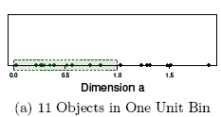
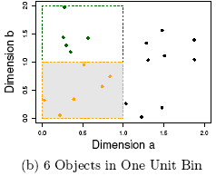
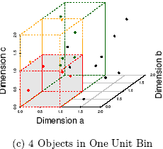
The Curse of Dimensionality
(graphs adapted from Parsons et al. KDD Explorations 2004)
Data in only one dimension is relatively packed
Adding a dimension “stretch” the points across that dimension, making them further apart
Adding more dimensions will make the points further apart—high dimensional data is extremely sparse
Distance measure becomes meaningless—due to equi-distance

Slide 50
Summary
Cluster analysis groups objects based on their similarity and has wide applications
Measure of similarity can be computed for various types of data
Clustering algorithms can be categorized into partitioning methods, hierarchical methods, density-based methods, grid-based methods, and model-based methods
Outlier detection and analysis are very useful for fraud detection, etc. and can be performed by statistical, distance-based or deviation-based approaches
There are still lots of research issues on cluster analysis

Slide 51
Problems and Challenges
Considerable progress has been made in scalable clustering methods
  Partitioning: k-means, k-medoids, CLARANS
  Hierarchical: BIRCH, ROCK, CHAMELEON
  Density-based: DBSCAN, OPTICS, DenClue
  Grid-based: STING, WaveCluster, CLIQUE
  Model-based: EM, Cobweb, SOM
  Frequent pattern-based: pCluster
  Constraint-based: COD, constrained-clustering
Current clustering techniques do not address all the requirements adequately, still an active area of research

